Slide 1
Measuring Anti-Chinese Comments in Coronavirus Tweets
Team 10
Abdullah AlOthman, Felipe Buchbinder, Jingjing Shi, Joseph Krinke

Slide 2
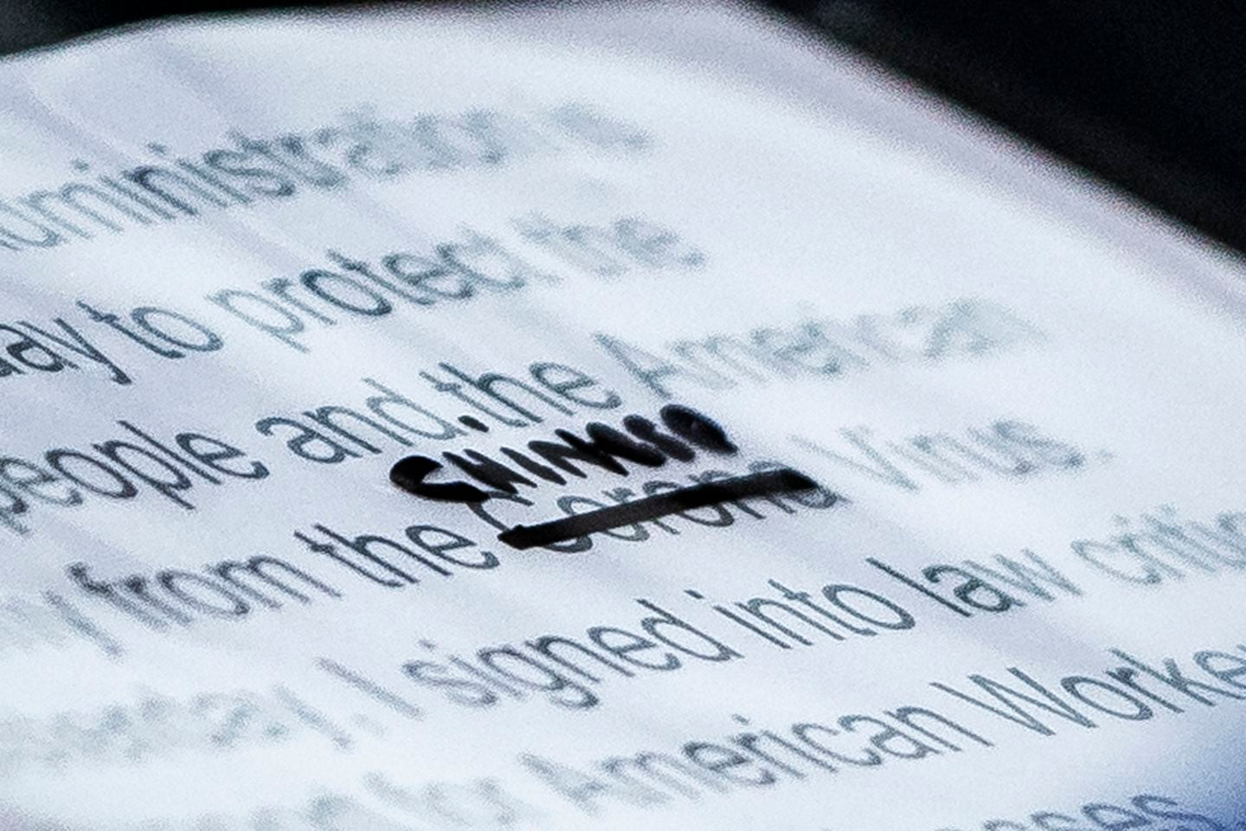
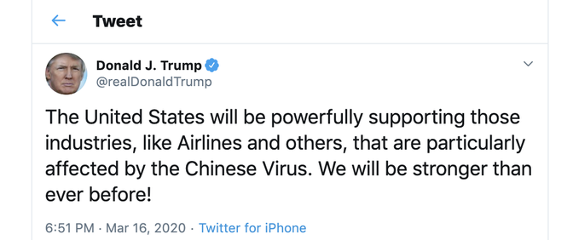
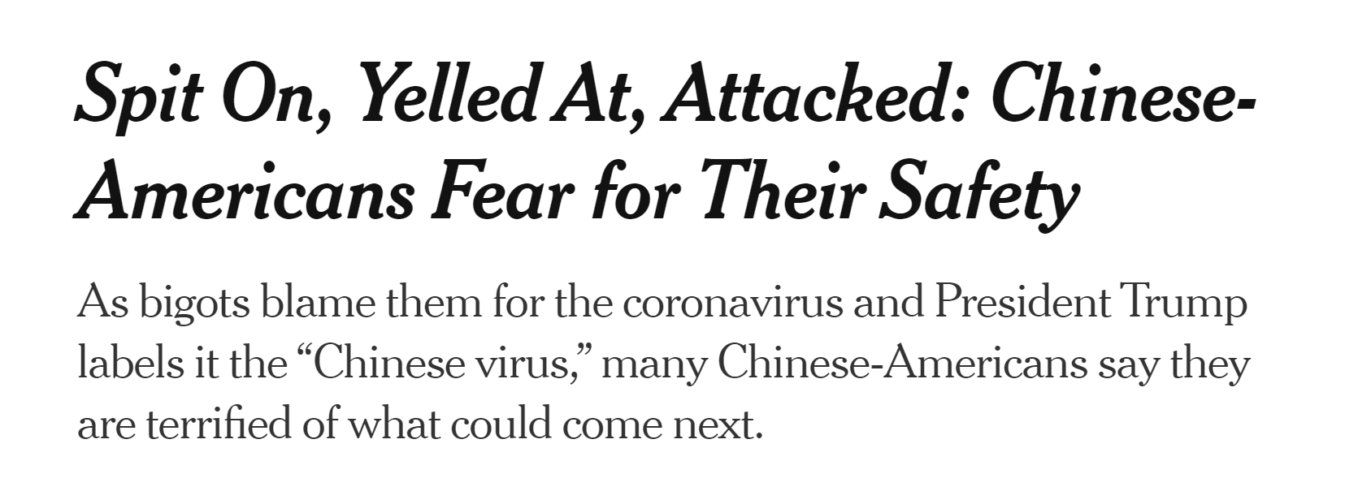
Motivation

Slide 3
Data Source
Covid-19 Twitter Chatter Dataset for Scientific Use
(PanaceaLab - COVID19 Twitter Dataset Homepage)
Data collected from Twitter stream
Keywords: COVD19, CoronavirusPandemic, COVID-19, covid19,
2019nCoV,CoronaOutbreak, coronavirus,
WuhanVirus,coronaviruspandemic, covid-19,
2019ncov, coronaoutbreak, wuhanvirus
Tweet IDs + Timestamps

Slide 4



Processing
Tweets Containing Keywords About China: ~90,000
Hydrated 10% Sample: 2.4 Million
Tweets Tweeted After March 1st: 24.7 Million

Slide 5
Sentiment Model
We trained a deep learning model that labels texts with their likelihoods of containing comments that fall into any of the following categories:
Severely Toxic
Identity Attack
Insult
Threat

Slide 6
Sentiment Model
Trained on an annotated comments dataset provided by Jigsaw’s Conversation AI team.
Information about the labeling schema used to create that dataset is available on the dataset’s webpage.
The model scored an average of .98 AUC score across the labels.

Slide 7
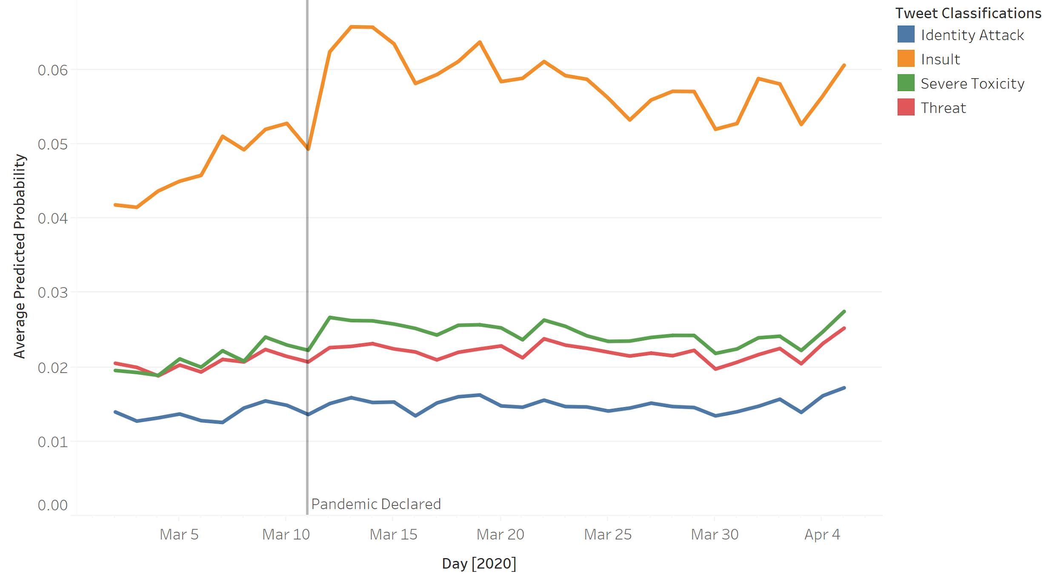
Overall Trends in Coronavirus Tweets

Slide 8
Tweets Related to China Were More Negative

Slide 9
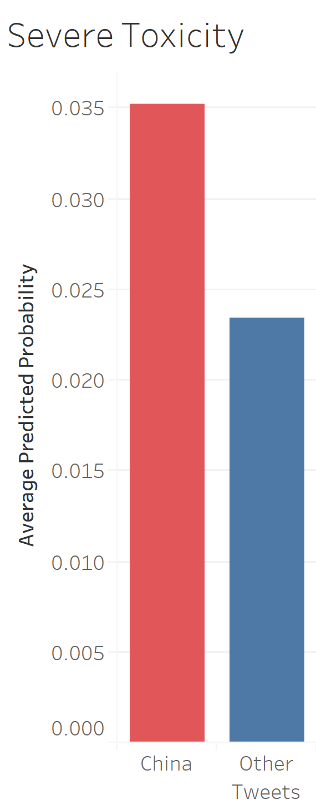
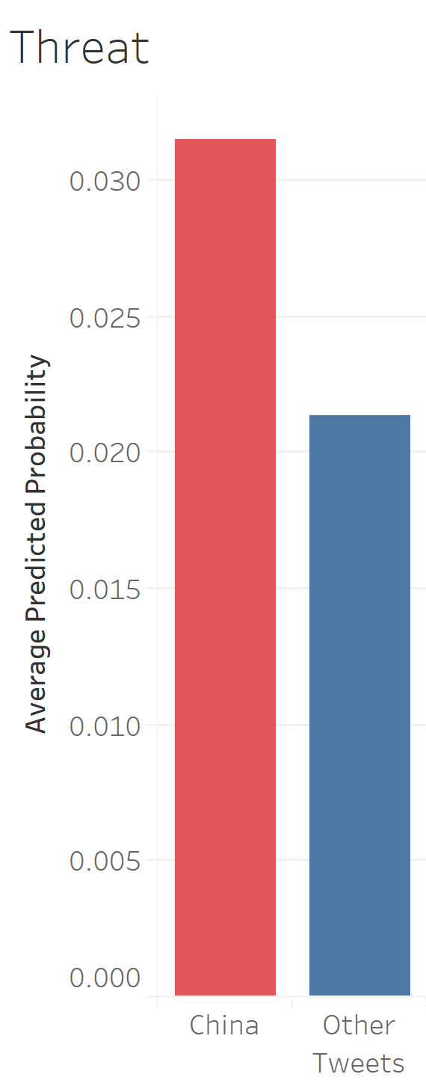
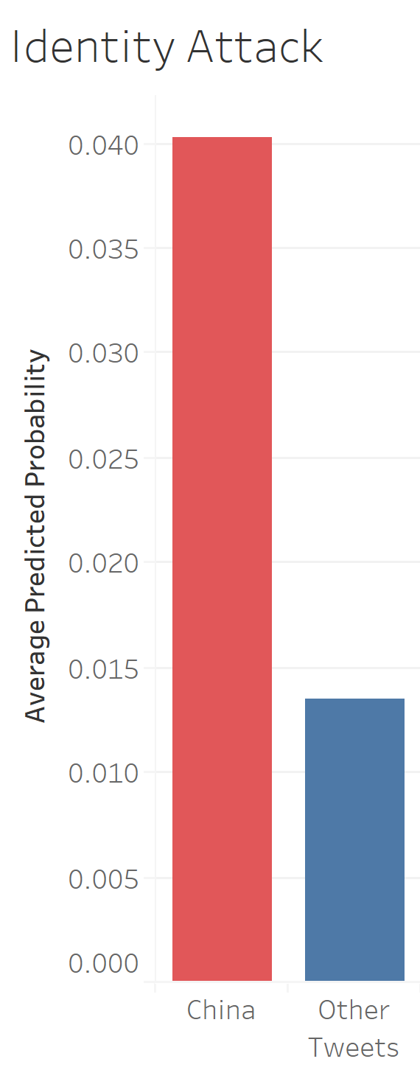
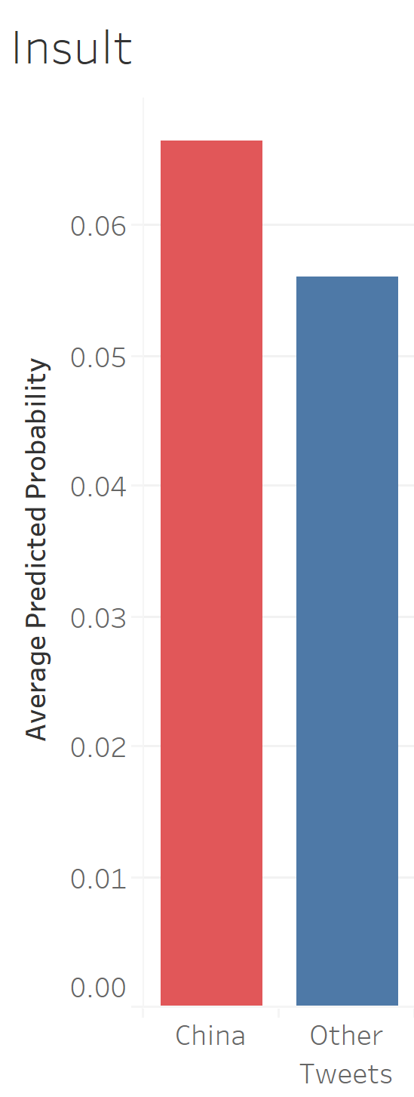

Slide 10
Sample Tweets

Slide 11
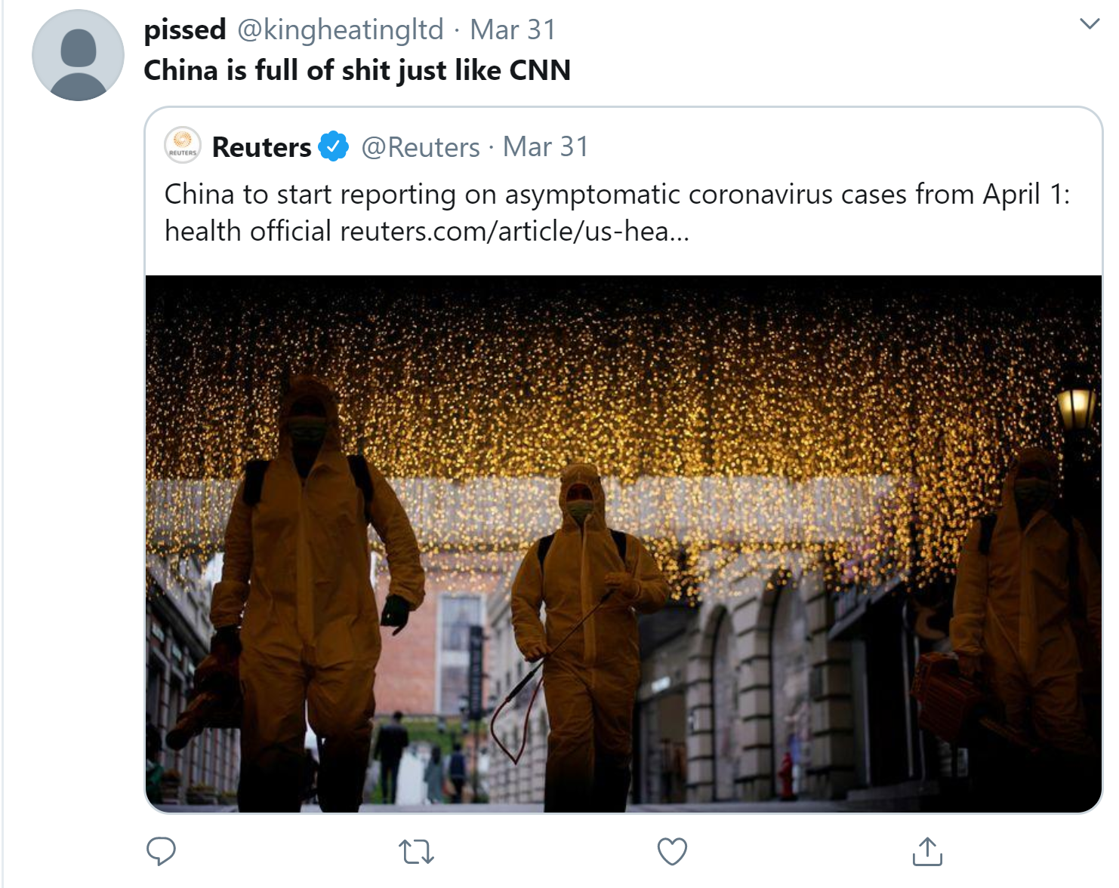
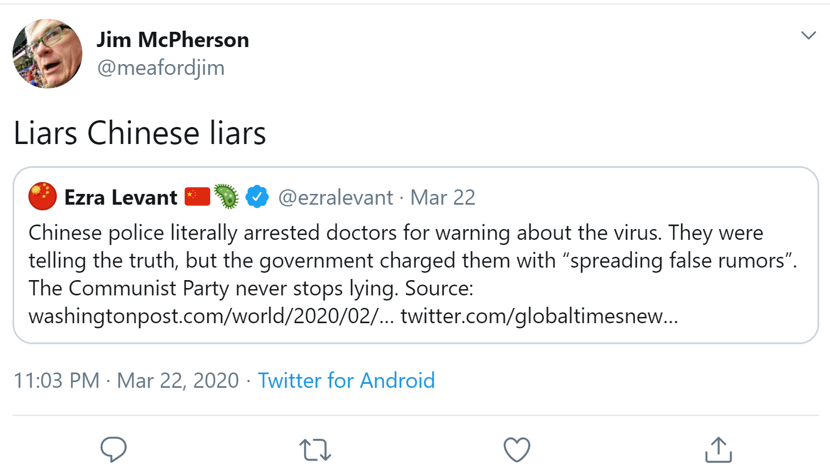
Insult Identity Attack

Slide 12
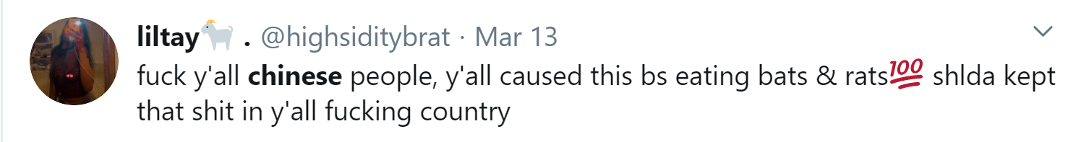
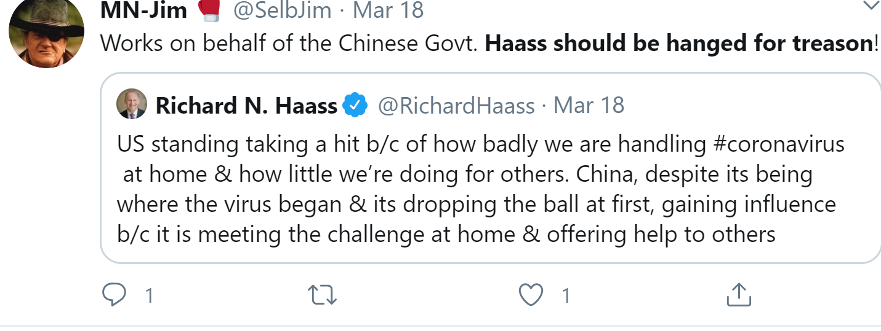
Severe Toxicity
Threat

Slide 13
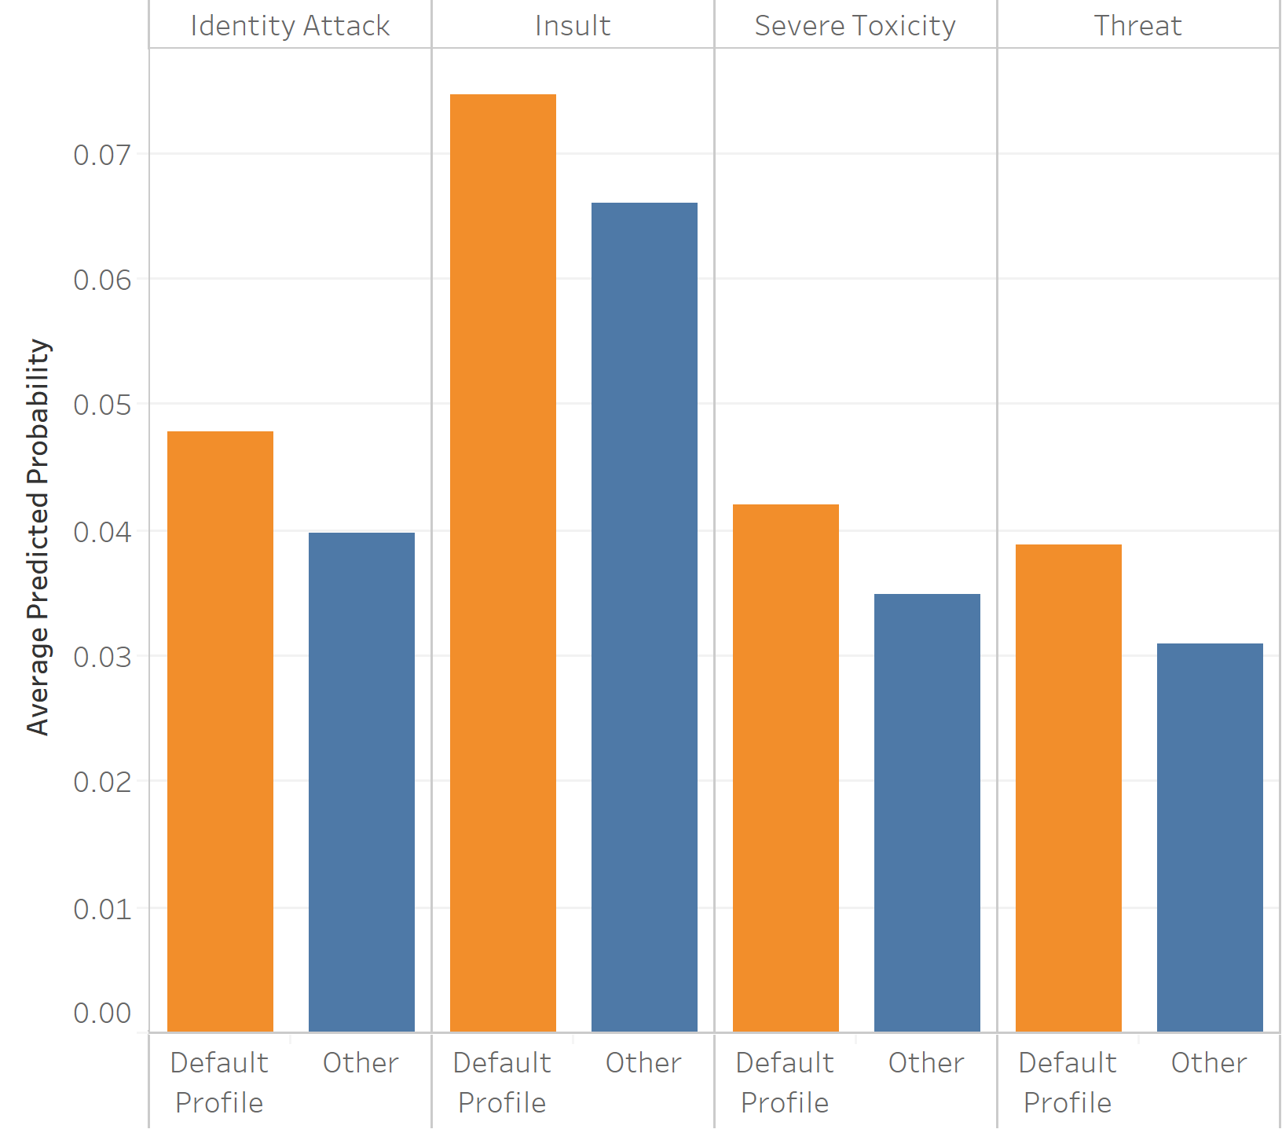
Tweets from Users With Default Profile Pictures Were Also More Negative

Slide 14
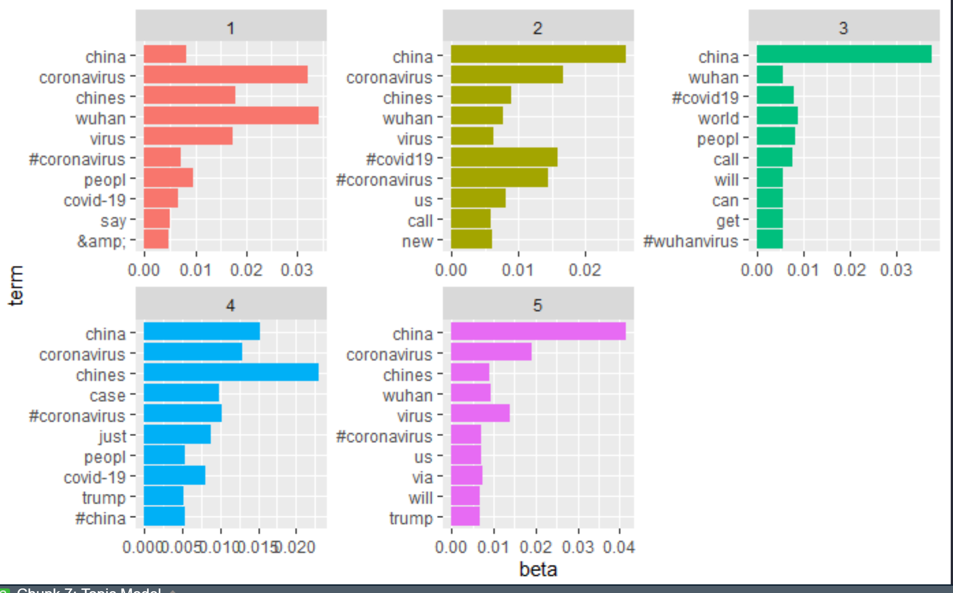
Topic Model

Slide 15
Future Work
Clean Data Further For Topic Modeling
Attempted It- Most Topics Were Similar
Consisted of Non-Meaningful Terms
Coronavirus, Virus, Etc
Investigate Bots’ Role in Negativity
No Profile Picture?
Apply Bot-Detection Models

